Slide 1

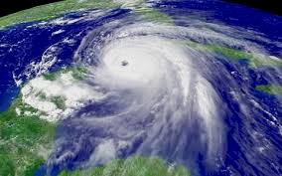
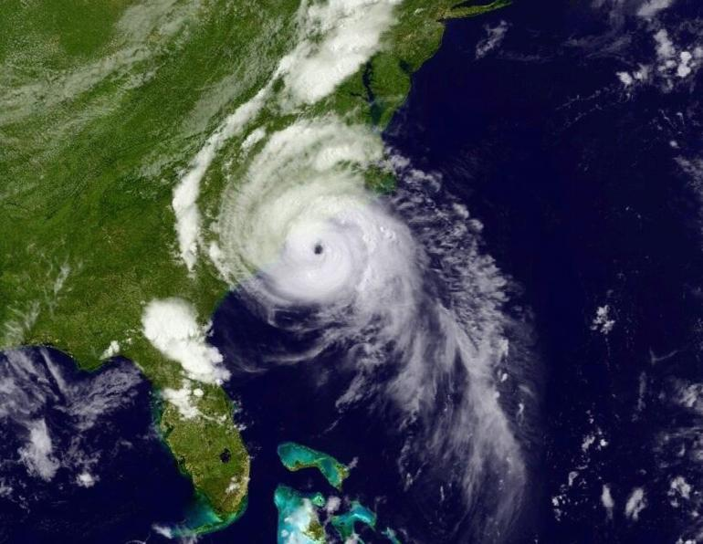
HFIP at the 5 Year Point
69th Interdepartmental Hurricane Conference
Fred Toepfer
March 4, 2015
Notes:
2009 Ida
2014 Arthur

Slide 2

HFIP Motivation
Decrease Evacuations
  Increase forecast accuracy,
    especially at longer lead times
    especially during periods of rapid intensity changes;
  Raise confidence levels for all forecast periods

Slide 3
HFIP
Our Charter
Improve hurricane forecast system and global forecast systems Track and Intensity Forecast Guidance to NHC
Make better use of existing Observing Systems and define Future Observing System Needs
Expand and Improve forecaster tools and applications to support NHC
Includes all necessary
Research, Demonstration, Development, Transition and Implementation

Slide 4
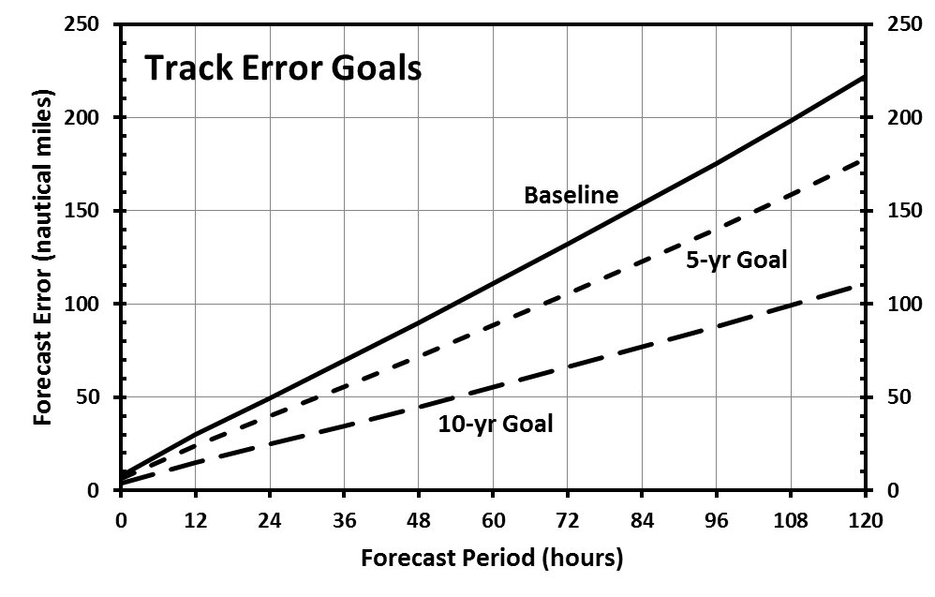
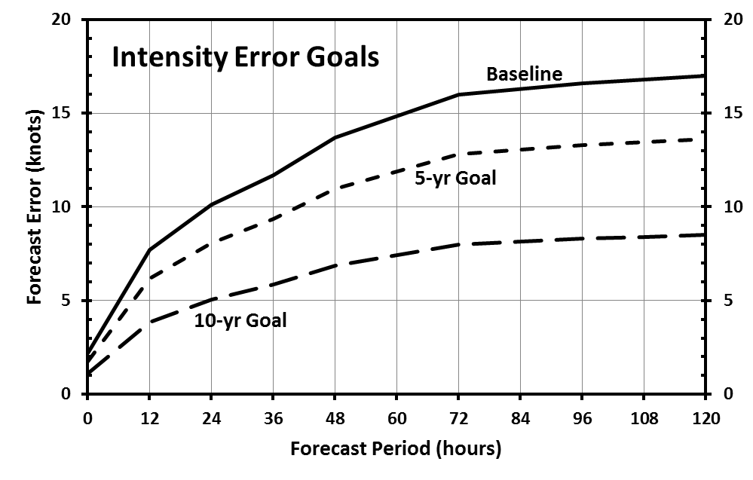
Aggressive Goals
HFIP Performance Goals
Vision
  Organize the hurricane community to dramatically improve numerical forecast guidance to NHC in 5-10 years
Goals
  Reduce numerical forecast errors in track and intensity day 1 to day 5
    20% in 5 years,
    50% in 10 years
  Extend forecast guidance to 7 days with skill comparable to 5 days at project inception
  Increase probability of detection (POD) for rapid intensity change to 90% at day 1 decreasing linearly to 60% at day 5
  Decrease the false alarm ratio (FAR) for rapid intensity change to 10% for Day 1 increasing linearly to 30% at Day 5
  Improve storm surge prediction
Key to Success: Community Engagement with Accelerated Research to Operations
4

Slide 5
HFIP Strategy
Accelerating Research to Operations
Key Steps: Broader Community Participation and Accelerated Research to Operations:
Aligned focused research efforts within NOAA and with interagency and academic partners;
Established a process to leverage outside research capabilities in support of project objectives (Federally funded grantees working within a community code repository);
Defined and implemented a solution (the seasonal, real-time experimental forecast system) to accelerate research into operational products; and
Established a high performance computing infrastructure and attendant protocols to support research-to-operations activities.

Slide 6

HFIP R&D HPC
Configuration of Jet System
 | Install Date | Total Cores | Performance (Tflops) | Storage (TB)
Phase 1 (Njet) | Aug 2009 | 3184 | 35.6 | 350
Phase 2 (Tjet) | Aug 2010 | 10600 | 113.0 | 416
Phase 3 (Ujet) | Oct 2011 | 16648 | 182.0 | 1166
Phase 4 (Sjet) | Aug 2012 | 22088 | 272.0 | 1613
No Upgrades | 2013
Phase 5 (Vjet) | Aug 2014 | 24456 | 340.26 | 3261
Phase 6 (planned) | ~Jul 2015 | ~30152 | ~576.0 | 3261

Slide 7
Mission-Oriented Research
University 2yr Grants ($3.78M)

Slide 8
HFIP Accomplishments
Public-private partnership teams established to significantly broaden scientific approach to the problem
Improved flows of research into operations
Improved Data Assimilation and Modeling Technologies (Global and Hurricane scale) for improved track and intensity forecasts
Better Use of Aerial Reconnaissance to Improve Model initialization
Improvements in numerical guidance appear to be showing up in NHC official forecast for track and intensity

Slide 9
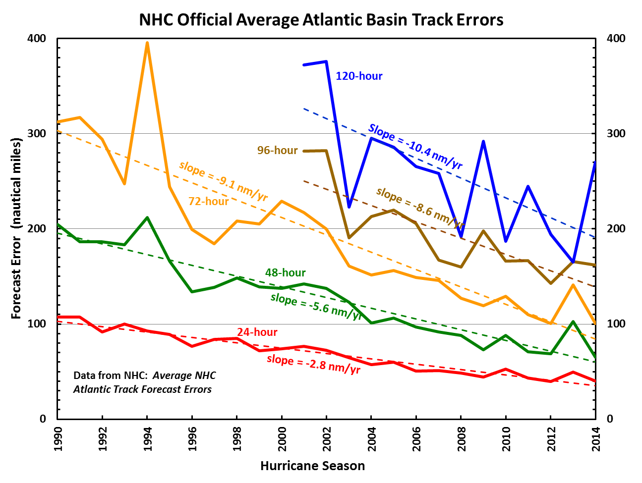
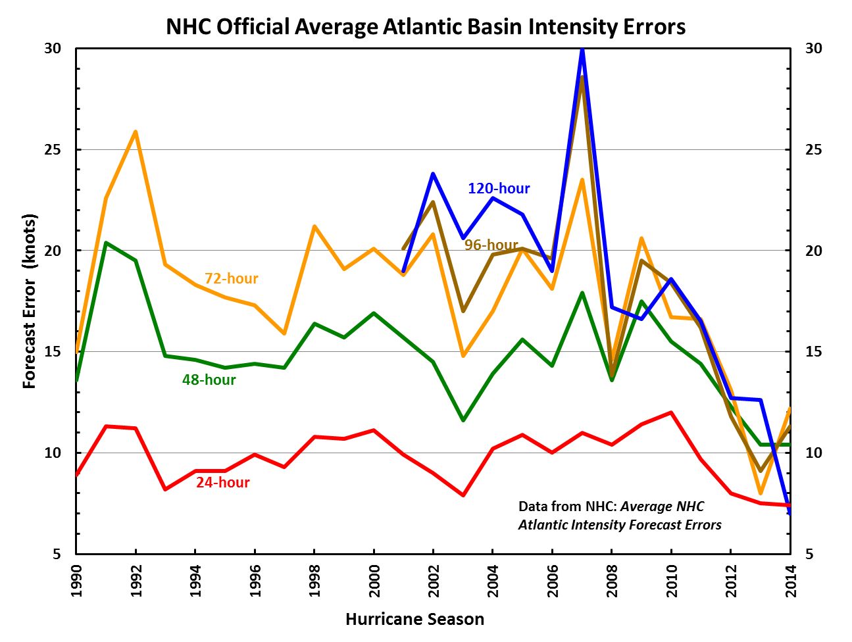
Progress & Accomplishments
Are we seeing an Impact?
Operational Forecast Performance
Errors cut in half over past 15 yrsears
10-yr improvement - As accurate at 48 hrs as we were at 24 hrs in 2000
24-48h intensity forecast historically off by 1 category (2 categories perhaps 5-10% of time)

Slide 10
Highlights for 2014
2014 HWRF operational implementation
  Increased vertical resolution (from 43 to 61 levels)
  Revised and advanced vortex initialization including cycling of invests
  Improved nest tracking, more advanced vortex initialization, and advanced diagnostic products
  Transitioning HWRF into NMM-B (convert E-grid to B-grid) has begun
NHC Operational forecast improvements
  Intensity error trend was much lower than 5 years ago
  Track skill suggests 5yr HFIP goal accomplished and upward trend continues
Basin-Scale HWRF
  Prototype for multi-nested regional to global scale models
Demonstrated multi-model regional ensemble (HWRF/COAMPS/GFDL)
  40 member ensemble run on Jet in Real-time demo
  Develop high-resolution probabilistic products
Statistical post processing of model output to further increase forecast skill
  Synthetic satellite verification
  Expand SPICE to global coverage

Slide 11
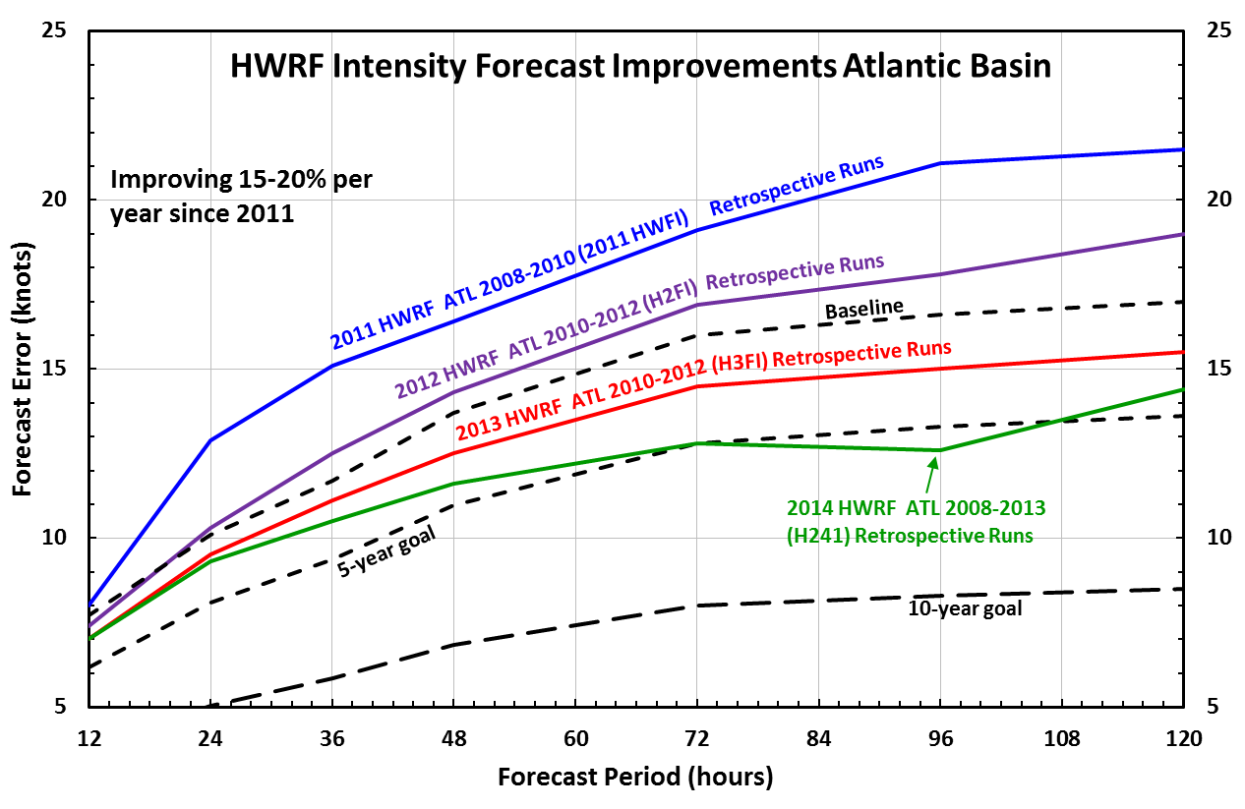
HFIP Progress:
HWRF Intensity Atlantic Basin

Slide 12
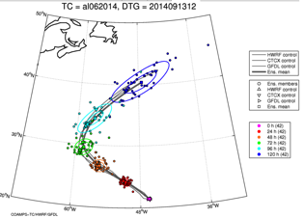
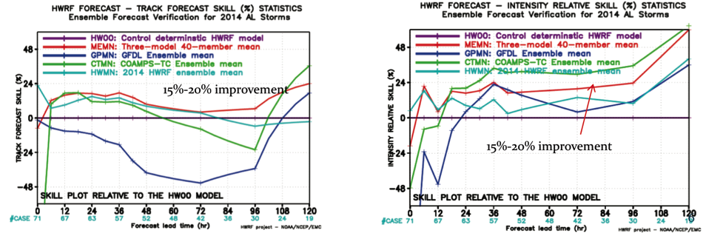
Multi-model Regional Ensemble
HWRF EPS (27/9/3 km, 42 levels) – 20 members
GFDL EPS (55/18/6 km, 42 levels) – 10 members
COAMPS-TC EPS (27/9/3 km, 40 levels) – 10 members
Skill relative to operational HWRF

Slide 13
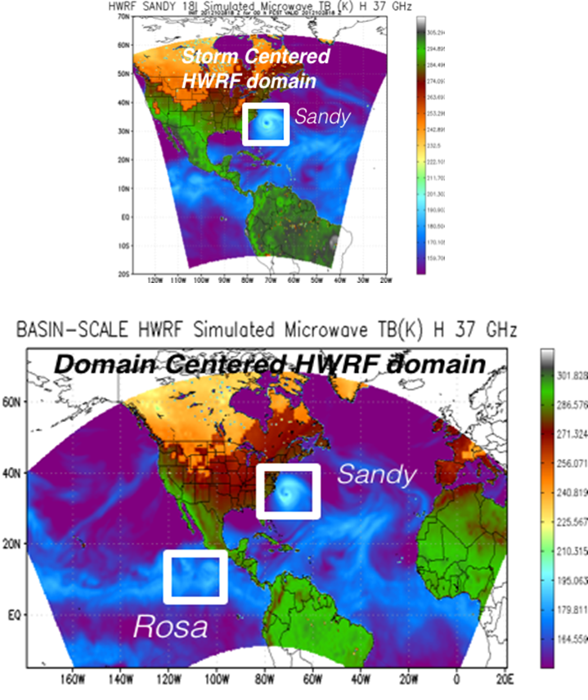
Basin-Scale HWRF
Storm Centric -VS- Domain Centric Forecasts
Tropical predictions system (Extended predictions)
Improved storm-storm & multi- scale interactions
Landfall and post landfall (storm surge & rainfall)
Genesis
Regional ensembles
Data assimilation

Slide 14
Highlights for 2014
(cont.)
  JTWC evaluating HWRF guidance globally using HFIP Demonstration System on Jets
  HWRF WPAC demonstrated improved RI guidance – POD 22% vs JTWC operational 4%
  Demonstrated impact of aircraft observations on forecast guidance
  Demonstrated next generation storm surge model – WRN

Slide 15
HWRF RI in WPAC
HWRF
2012-2013
JTWC
2012-2013
If RI event defined as >30 kt/24 h, HWRF RI POD skill is ~ 22% and has much higher POD compared to operations and other models (previous analysis of RI for WPAC in 2012 showed <10% skill).

Slide 16
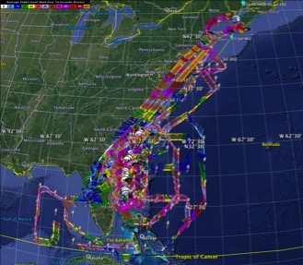

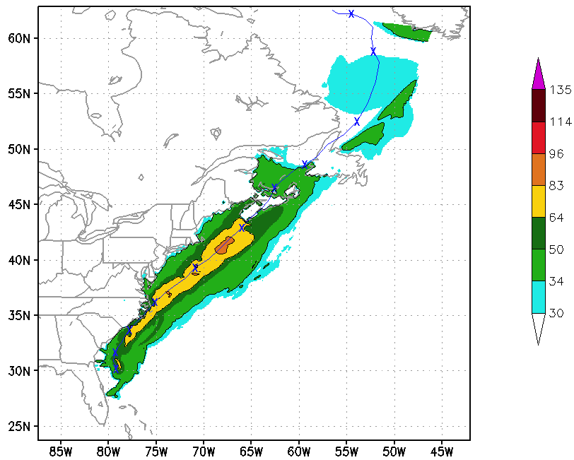
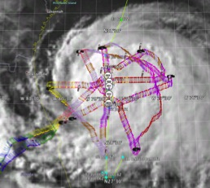
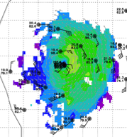
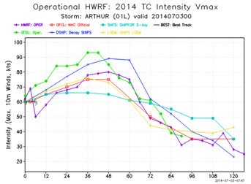
Real-time Use of Aircraft Obs:
Arthur 2014
5 P-3 Flights
2 July – 5 July 2014
Doppler data transmitted in real-time for assimilation into HWRF
5 P-3 missions from 2-5 July 2014 at 12 h Doppler sampling (HEDAS/GSI) & 3 G-IV missions
Sampled Arthur as a tropical storm to hurricane at landfall in NC, to extra-tropical transition in Nova Scotia
16
Notes:
Map shows flight tracks for all of the NOAA missions (color coded are the flight level winds for the P-3 missions, dropsonde symbols denote G-IV patterns)
Flight track plots courtesy of Tropical Atlantic - http://tropicalatlantic.com/recon/
Model data available at: http://www.emc.ncep.noaa.gov/gc_wmb/vxt/RT_ATLANTIC/ARTHUR01L/

Slide 17
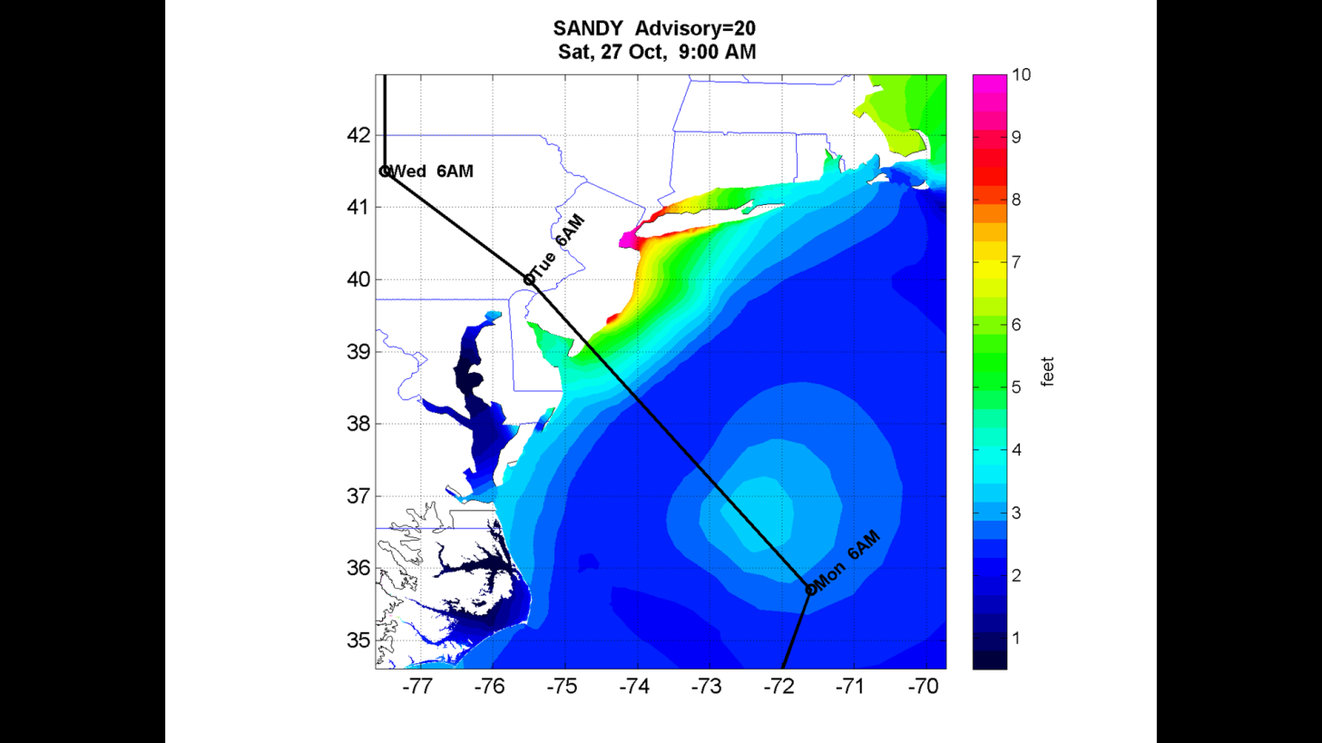
36-hr Storm Surge Forecast ADCIRC
Forecast about 10 feet surge in New York Harbor and near Atlantic City, NJ -- very close to the observed
Maximum storm surge forecast for Hurricane Sandy from the ADCIRC storm surge model made 36 hours before landfall. Sandy’s track is shown in black

Slide 18
HFIP Priorities
Near-Term
Operational
HWRF Upgrades for 2015 hurricane season and future plans
  Increased horizontal resolution from 27/9/3km to 18/6/2km
    Improved physics packages for 2km resolution
  HWRF Data Assimilation System to include GFS EnKF driver and assimilation of P3 TDR and P3/G-IV/AF/GH dropsonde output
  HWRF transitioning towards unified NMMB/NEMS infrastructure (2016-2017)
Research and Development
Further development and testing of HFIP Multi-model Regional Ensemble System (20-member HWRF, 10-member COAMPS-TC and 10-member GFDL)
Continue to improve physics packages
Improve use of satellite datasets focusing on hi-res AMVs and microwave
Real-time demo of three-way coupled HWRF-POM/HYCOM-WAVEWATCH-III modeling system
Continued Basin-scale HWRF development - couple to ocean and advance DA system

Slide 19
Challenges!
FY15 Budget Reduction
Maintain Community Involvement
Operational Partnership for Multi-Model Ensembles in all Basins
Expand International Participation
Focus on Improvements of model physics (scale aware), vortex initialization and data assimilation
Evolution of Hurricane Forecast System will include
  global-to-local scale predictions with emphasis on multi-scale interactions
  Improved forecasts for land falling storms and downstream applications
  Precipitation after land fall
  Development of Nesting Technology for Global Models
Continued focus on high-resolution ensembles, advanced air-sea-wave-land-hydrology coupled systems
Improved products to the forecasters
We Will Achieve Long Term Goals – just will take little longer!

Slide 20
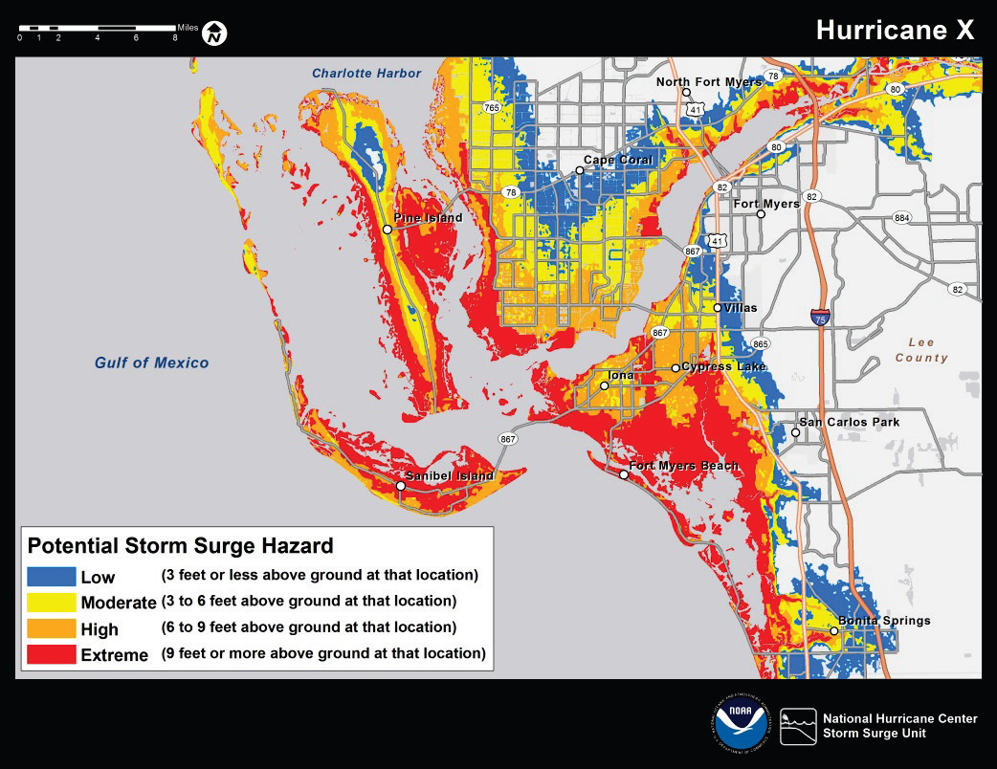
Potential Advisory Product

Slide 21
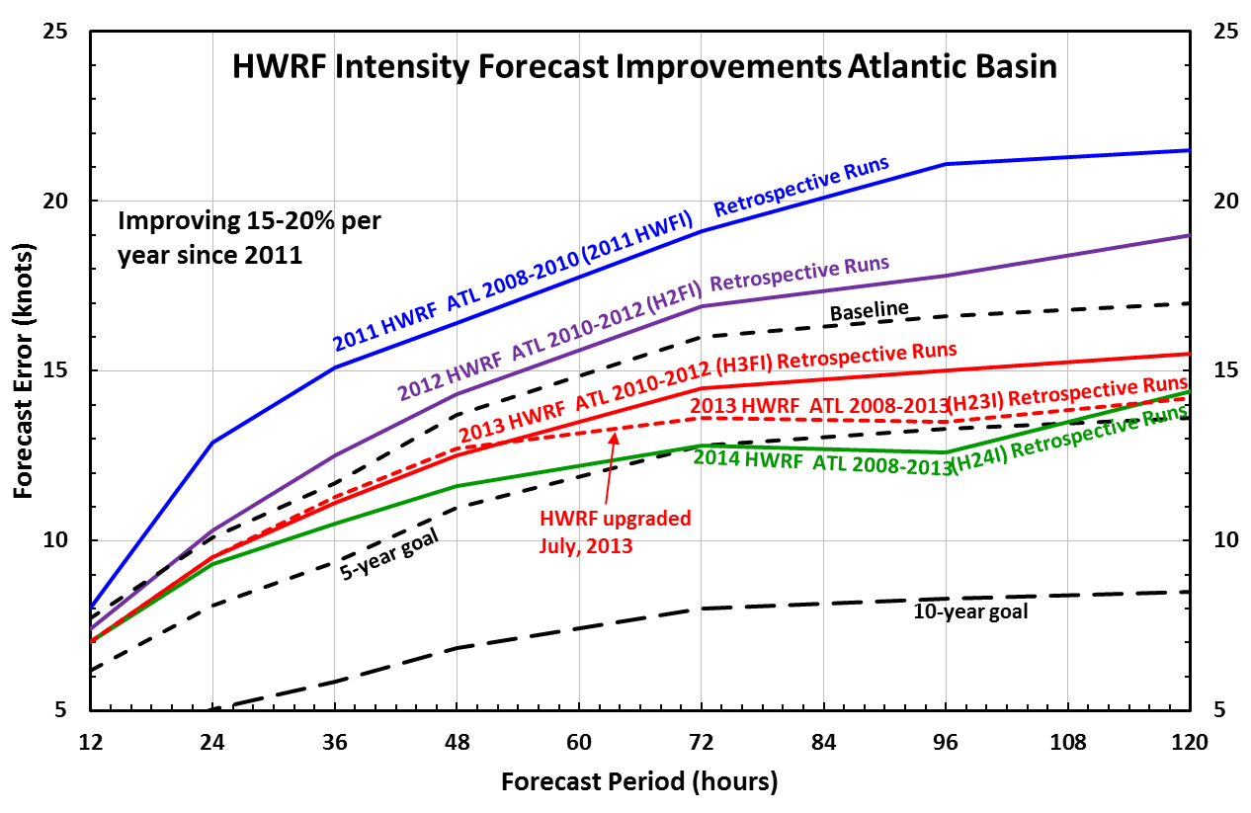
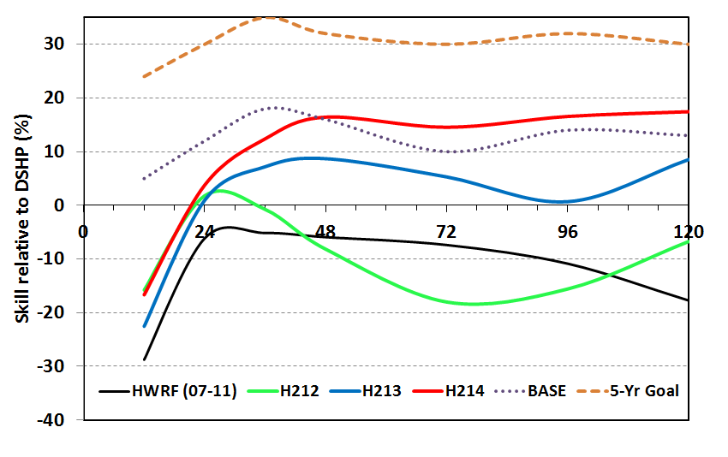
High Priority: Address Rapid Short-term Intensity Error Growth
Focus area for improvements: Much to do with getting more accurate initial vortex structure and environment (where observations and DA are critical)

Slide 22
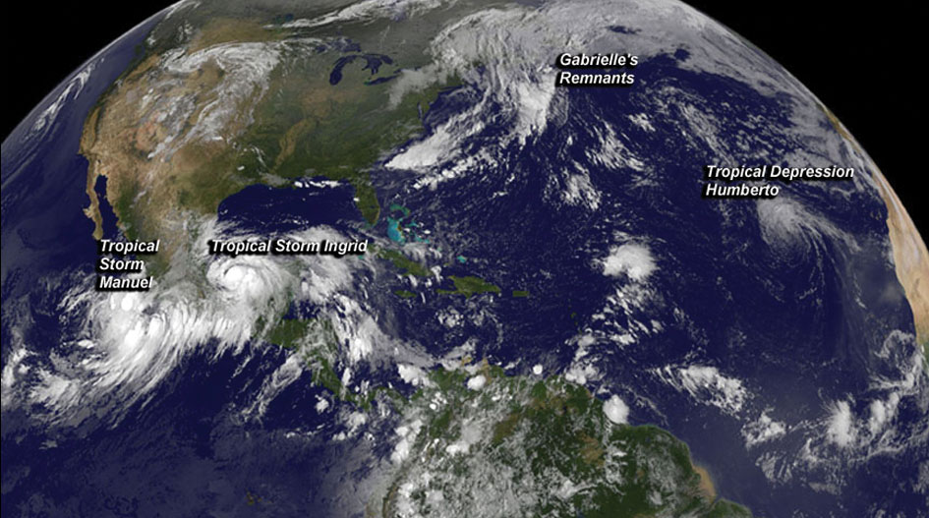
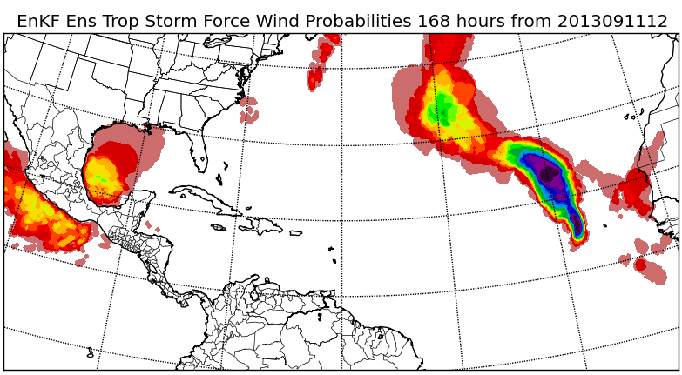
Wind Speed Probability Product
20130914
Notes:
Satellite image is three days after product posted (halfway through forecast duration)

Slide 23
  … Questions?

Slide 24
Operational Hurricane Modeling System Development
AOML
Development
  Init/DA
  Physics
  Dynamics
GFDL
Development
  Physics
  Initialization
  Ocean Coupling
Implementation
NHC/JTWC
  Diagnostics
  Ops Evaluation
  Recommendation
EMC
HFIP Stream 1.5
Real-time Demo & Stream 1.0
for JTWC
HWRF (AOML)
GFDL
MMM
Development
  Init/DA
  Physics
  Dynamics
HWRF Code Repository
  Dynamic cores
  Physics Packages
  Initialization Schemes
  Data Assimilation
  Single & Multi- Model Ensembles
  Grids
  Post Processing
Versions
of
Ops Code
AHW
EMC
Testing/ Eval/
Implementation
  Physics
  Initialization
  Diagnostics
  Op Support
NCO
Operational Code
Operational Runs
EMC
Ops
Code
Ops
Code
NRL
Development
  Init/DA
  Physics
  Dynamics
COAMPS-TC
HWRF
DTC
Code Management
Testing and Evaluation
Facilitate Academic Community Involvement
Facilitate International Collaboration
Outcome
Reach HFIP Goals on Intensity
EMC
HWRF Model Development
  Init/DA
  Physics
  Dynamics
  Ocean Coupling
Enabling Infrastructure
International Collaborations
China (CMA,STI)
India (IMD)
Vietnam (IMHEN)
Taiwan (CWB)
Oman (DGMAN
Academic Community
Research/Development
International
Partnerships
Research / Development

Slide 25
Calendar:
Operational Implementation
Activities | Approximate dates
Development of upgrades | Ongoing
Final development of proposed upgrades | September - December
Test of individual proposed upgrades | December - March
Final test of combined proposed upgrades | March
Pre-implementation test at NCO | April
HWRF operational implementation (AL & EP) | May
HWRF public release | August
Slide courtesy of DTC

Slide 26
Increase Forecast Lead Times
  Increase forecast accuracy at longer lead times, especially during periods of rapid intensity changes; raise confidence levels for all forecast periods

Slide 27
HFIP Overall Strategy
Near term: next 5 years
Investigate increase in error growth rate beyond 4-5 days
Use global models at as high a resolution as possible to forecast track out to 7 days
Use regional models at 1-3 km resolution to predict inner core structure to meet intensity goals out to 5 days including rapid intensification
Hybrid DA for both regional and global models using as much hurricane scale satellite and aircraft data as possible
Both regional and global models run as ensembles
Statistical post processing of model output to further increase forecast skill

Slide 28
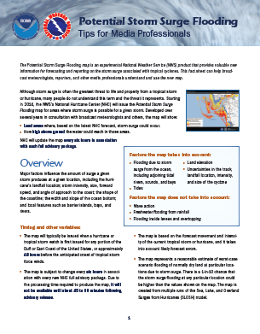
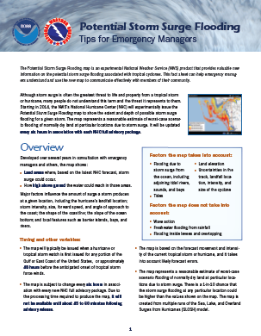
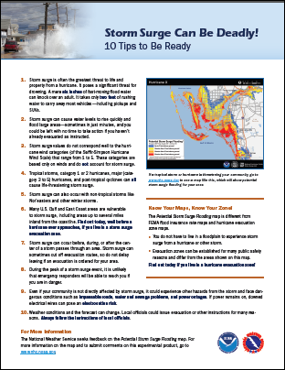
Tailored Products
Notes:
To assist in the outreach efforts, we developed short fact sheets for each of the key stakeholder groups: media professionals, emergency managers, and...

Slide 29
HFIP Overall Strategy
Long term: At the end of the 10 year HFIP Project
Merge the regional models with the global model
Start by developing a basin scale system
  Large outer domain but still within a Global model
    Global model only provides boundary conditions to outer domain
  Multiple inner nests, one set for each storm (9km, 3km)
    Two inner domains per storm, fully interactive with outer domain
Eventually the outer domain will be expanded to be global.
  Inner nests will then fully interact with the global model
Run as an ensemble
The global to regional models all constructed from the same model (NMMB) and run under NEMS framework.

Slide 30
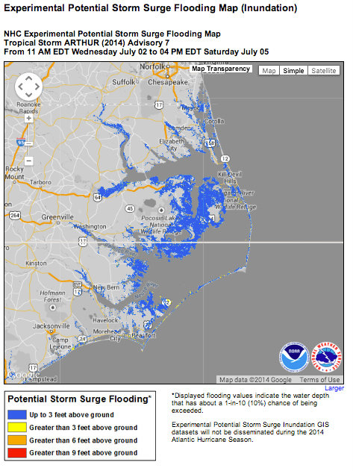

Efforts in the Tropical Surge
Hurricane Arthur
Potential Storm Surge Mapping
Physical & Social Science Integration
Holistic Approach
Wide Collaboration
Working with NOAA Partners
Notes:
synthetic SSMI/S 37 GHz imagery (brightness temps - used to detect & predict cyclone intensity based on features of the warm core)

Slide 31
Scientific Review Committee (SRC)
The SRC provides feedback and guidance contributing to the cohesion of near-term (next year or two) and longer range strategies for improving hurricane forecasts
Being outside of the daily project functioning, the SRC provides a broader assessment of HFIP progress and future approaches
  Review and suggest possible changes to annual HFIP plans
  Review preceding year accomplishments
  Review the long term HFIP model system development and observing strategy plans
  Review the objectives and makeup of the demonstration system each season
Organizational meeting 4th Quarter 2012
2 day review held 26 and 27 February, 2013
Second review meeting 28-30 July 2014

Slide 32
SRC Meeting - July 2014
Recommendations
Develop Alternative Measures of Success
  Restated opinion that present intensity goals are unreachable; reduction of the largest error (e.g., 90th percentile) may be more meaningful
  Consider metrics for defining size and shape of storm, and/or accuracy of the precipitation field structure
Relate Performance to External and Independent Guidance
  Continue reporting performance relative to SHIFOR and CLIPER (i.e., “skill”)
  Normalize regional model track performance to GFS forecasts to isolate regional model versus global model improvements
Place Less Emphasis on Global Models
Promote Probabilistic-based Products Useful to Forecasters
  Analyze forecast process: identify ways to best utilize probabilistic guidance (ensembles, etc.)
Concentrate on 12- to 48-hour Intensity Forecast Problem
  Inner core data assimilation

Slide 33
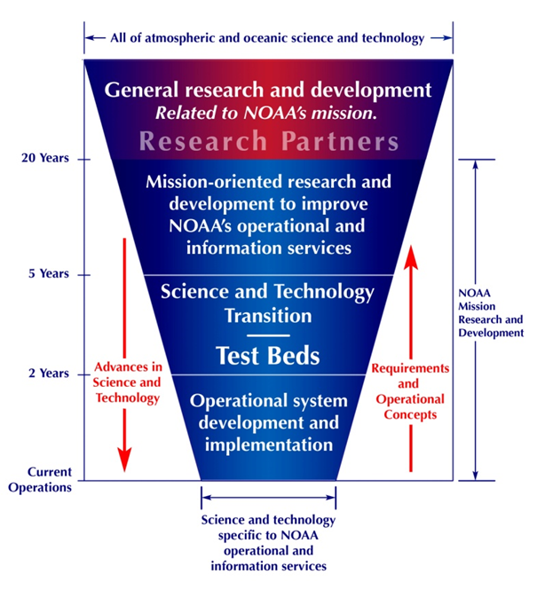
NOAA Research to
Operations Concept

Slide 34
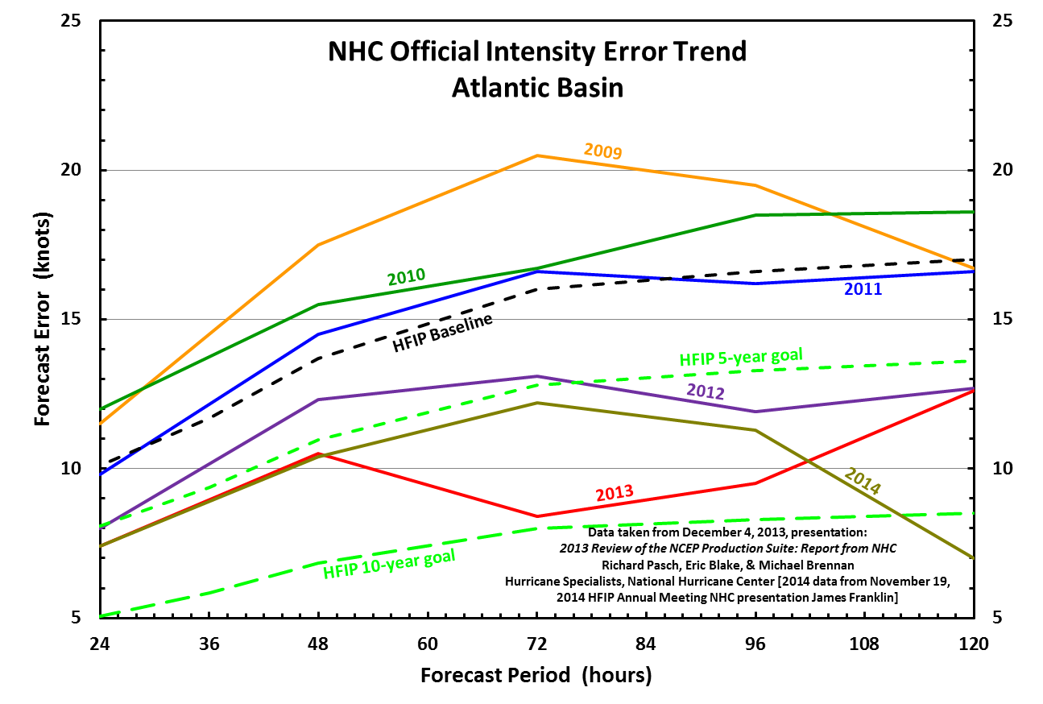
NHC OFCL Intensity Errors
Atlantic Basin

